Slide 1
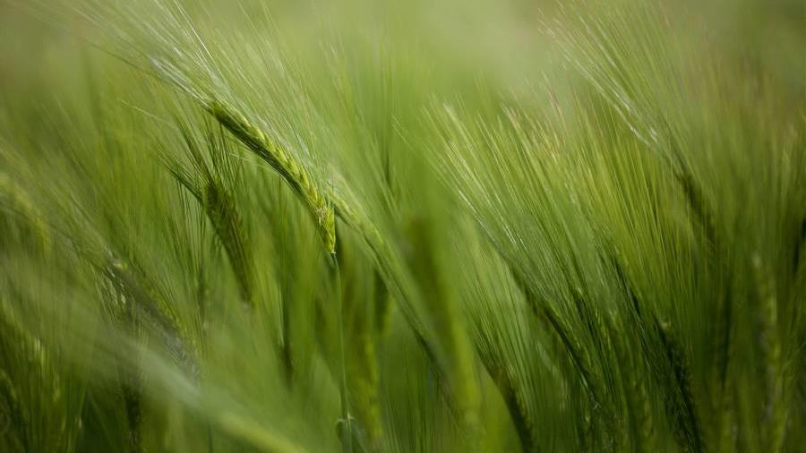
Krishi mandala
“Let us help farmers today, they will help us for the rest of our life.”

Slide 2

Introduction
At Krishi Mandala, we empower farming communities to foster collaborative thinking to further drive workplace innovation. By closing the loop and leveraging ethical farming methods, we help businesses grow organically and nurture a consumer first mindset.

Slide 3
problem
Suicide
financials
India is an agricultural country with around 70% of its people depending directly or indirectly upon agriculture. The number of farmers who are committing suicide day by day is increasing.
The indebtedness of farmers is one of the main reasons driving them to commit suicide. Farmers will not get sufficient money for what they sell. This is because of many individuals who is responsible for transporting products from farmers to customers. Crop fluctuations may lead to confusion to farmers to grow the particular crop.

Slide 4
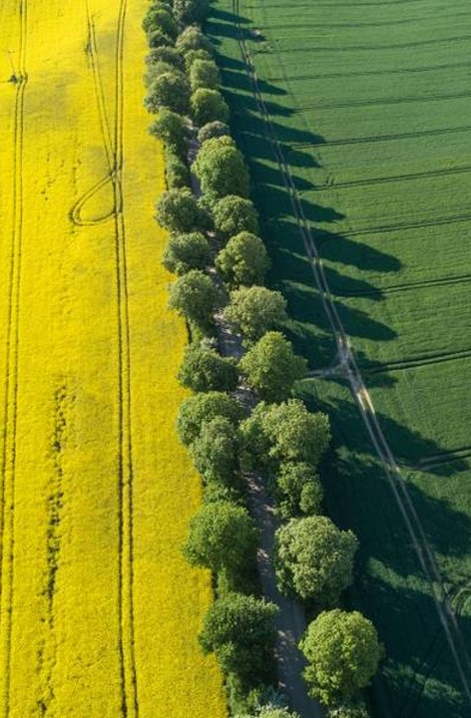
solution
Close the gap
Target audience
The main objective of this project is to connect farmers directly with their customers.
This may help farmers to get sufficient money without any intermediates. And also helps customers to get fresh products and at low price directly from farmers.
Farmers
Easy to use
A simple product that gives farmers the information they need in order to produce crops.

Slide 5




Type of accounts
admin
farmer
blogger
user
Manages users and verifies products and blogs.
Farmers will add their products which they have to sell.
Bloggers will write their blogs.
Users will buy the products which was added by the farmers.

Slide 6

Concepts We LEARNT
Python
Python is an interpreted language which has large library functions.
DBMS
The database is a collection of inter-related data which is used to retrieve, insert and delete the data efficiently.
HTML
The HyperText Markup Language is the standard markup language for documents designed to be displayed in a web browser. It can be assisted by technologies such as Cascading Style Sheets (CSS) and scripting languages such as JavaScript.

Slide 7
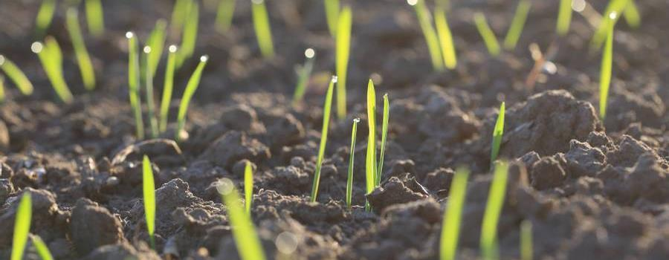
Extra features
Data visualization
Telegram
Static data retrieval from database to inform farmers about the previous crop rates.
Telegram is integrated to stay connected with farmers and to give updates about our website.
BLOGS
Bloggers will write the blogs only relevant to farming.

Slide 8
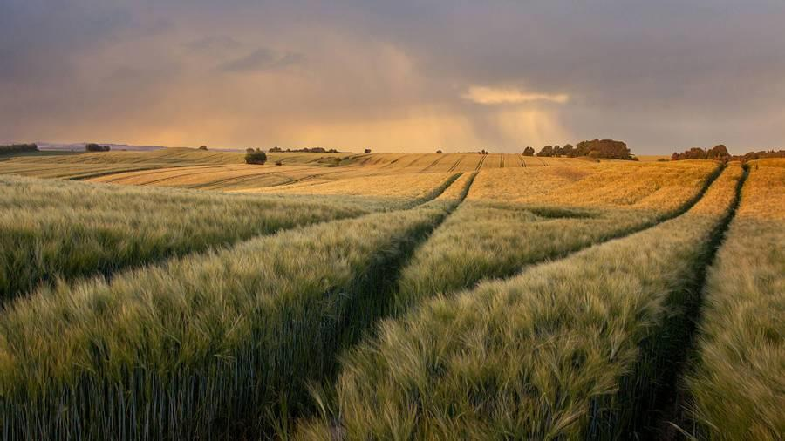
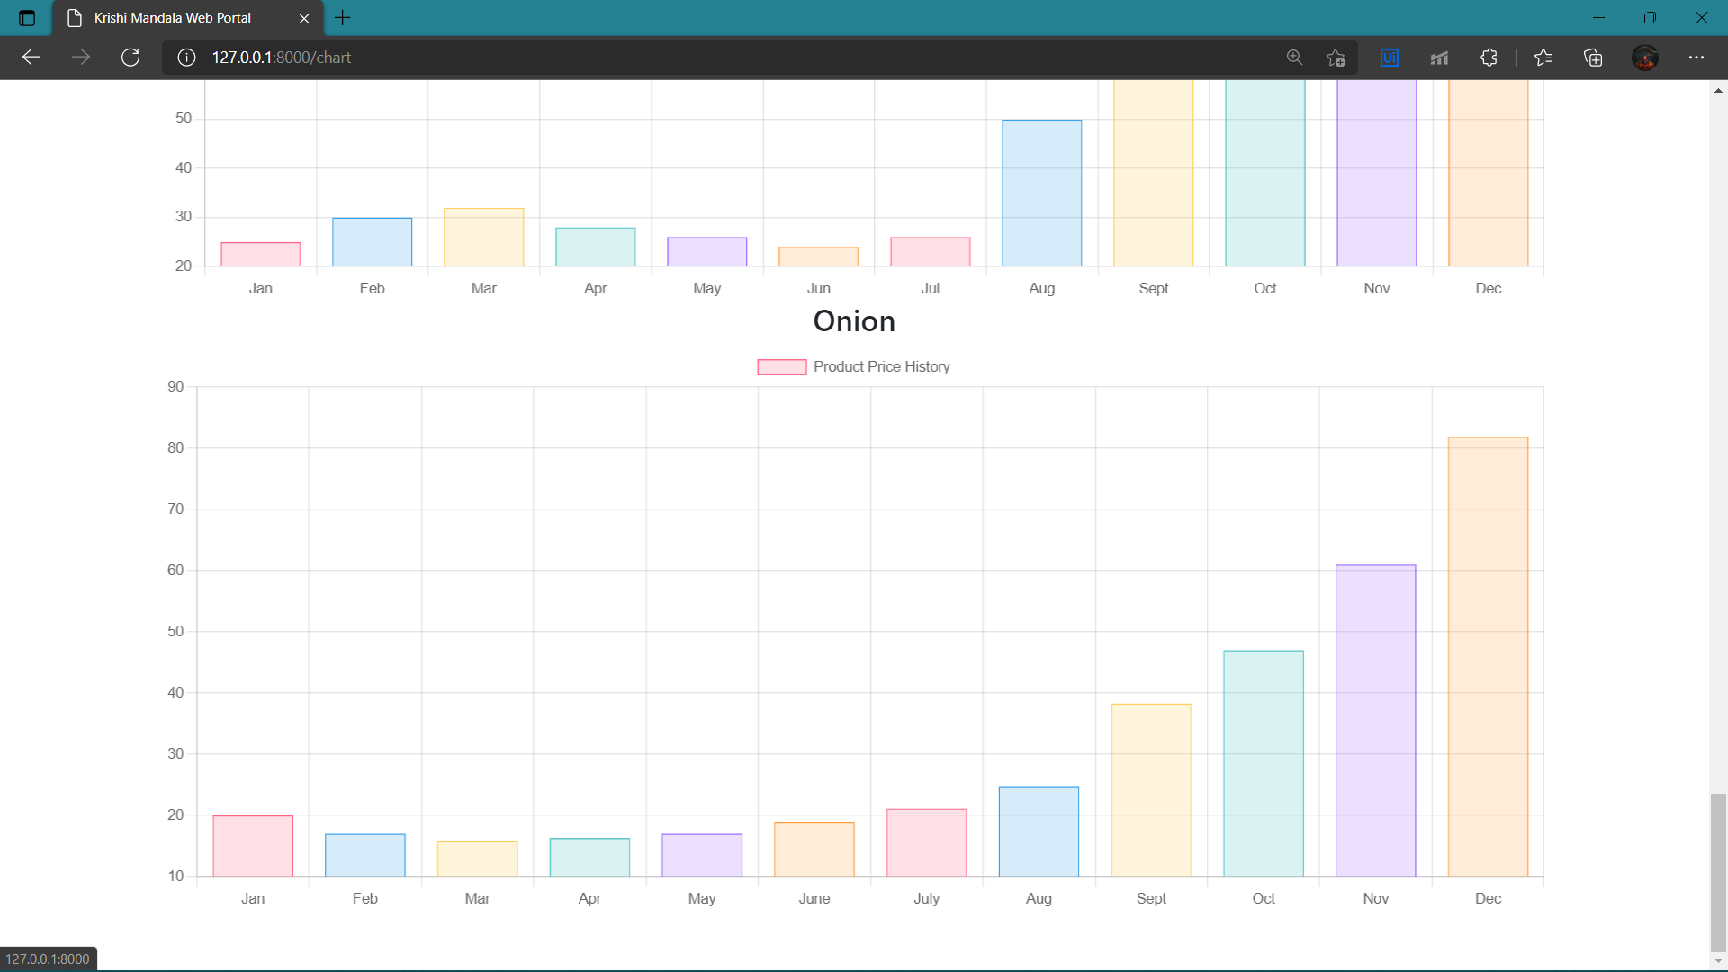
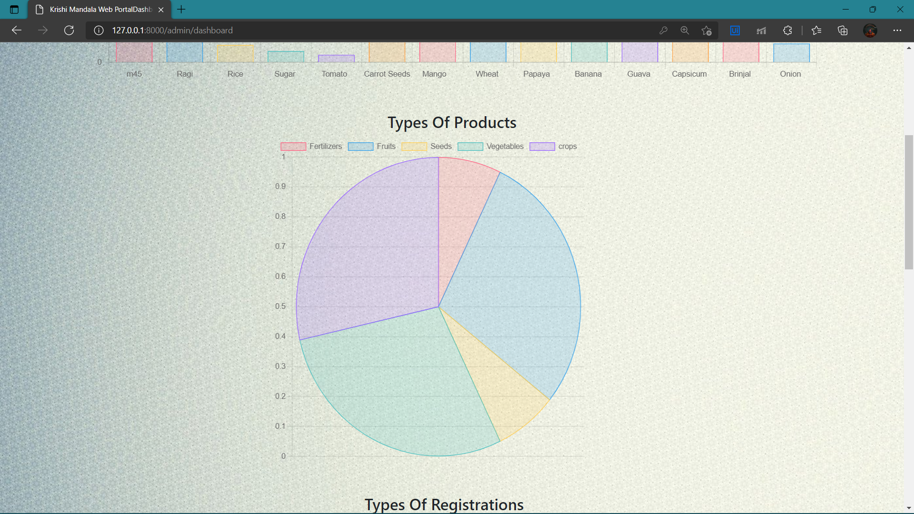
STATIC DATA VISUALIZATION

Slide 9
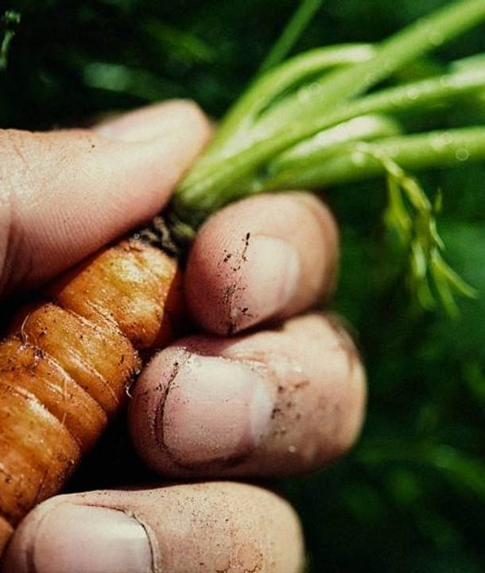
Blogs
Blogger will write blogs both in kannada and English​.
->​
It helps farmers to grow the crop efficiently and to correct their mistakes if any.
->
It gives the detailed description of the steps before starting farming.
->

Slide 10
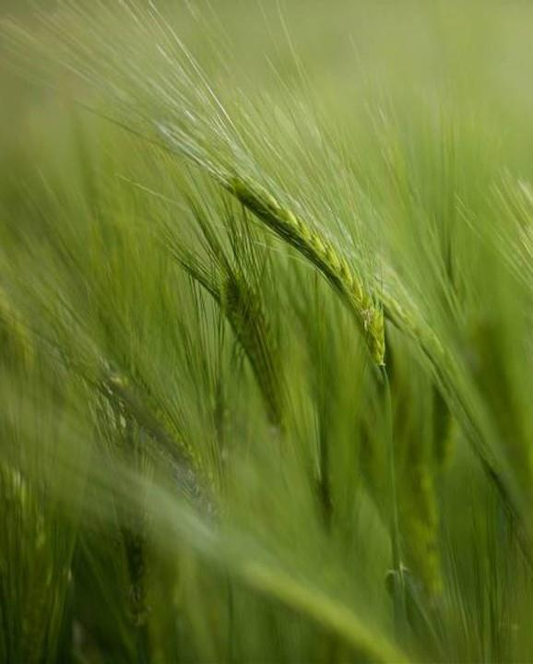

Telegram channel

Slide 11
Connectivity
A-admin
For the upliftment of Farmers, this website connects with them, collects the crop price according to their demand and produce the supply. Bloggers help farmers to know more about farming.
Totally the responsibility of growth of farmer is taken by this website.
Farmers
a
U-users​
B
u
b
u
​ B-Blogs

Slide 12
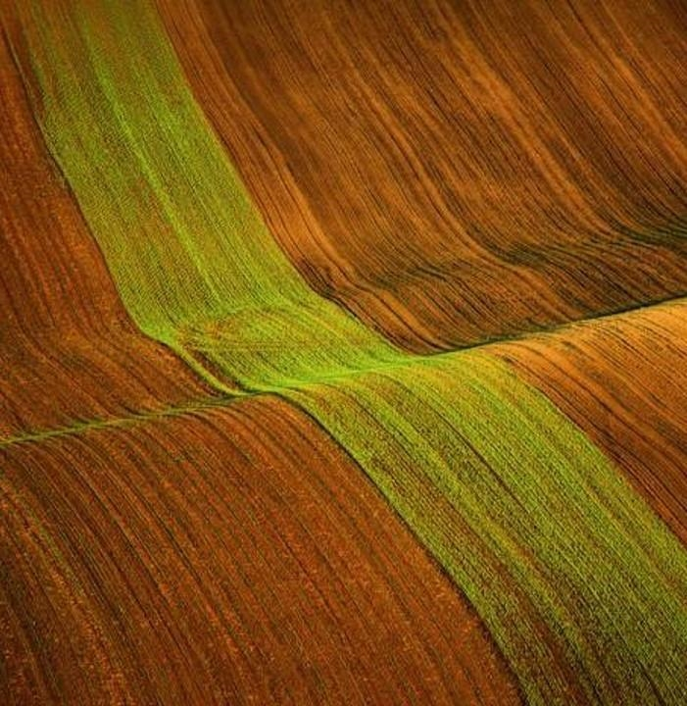
Thank you
This project is developed with python programming language. The project completely computerizes the existing system.
The agricultural sector is of vital importance for the region. Farmers are the backbone of our country. A village makes no progress if its farmers are not modern. In addition to the farmers contribute almost 17% of the Indian economy. That is the maximum of all. They are the ones who provide us all the food that we eat. As a result, the entire population of the country depends upon farmers.
“So let us help farmers today, they will help us for the rest of our life.”
-Sangeetha S
We would also like to say that it was very overwhelming to work with python.

